Slide 2
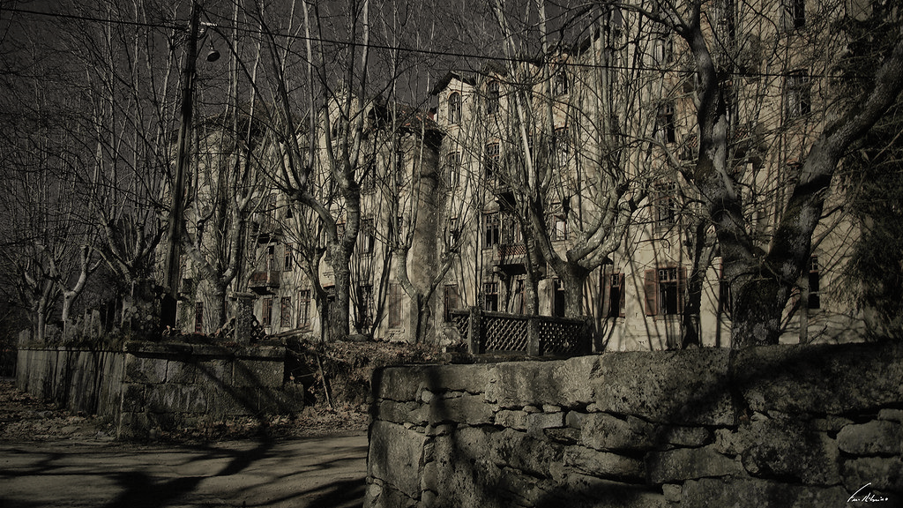
Python Hotel – Escape Room

Slide 3
At this fall…
Your skills will be tested…
And your survival will depend on it!

Slide 4
Python Hotel
A Python game using Pandas, Time, Openpyxl, Opensound and Pillow
A scary game with spooky scenarios and sounds!
Be the fastest to finish and compare the result with your friends!

Slide 5
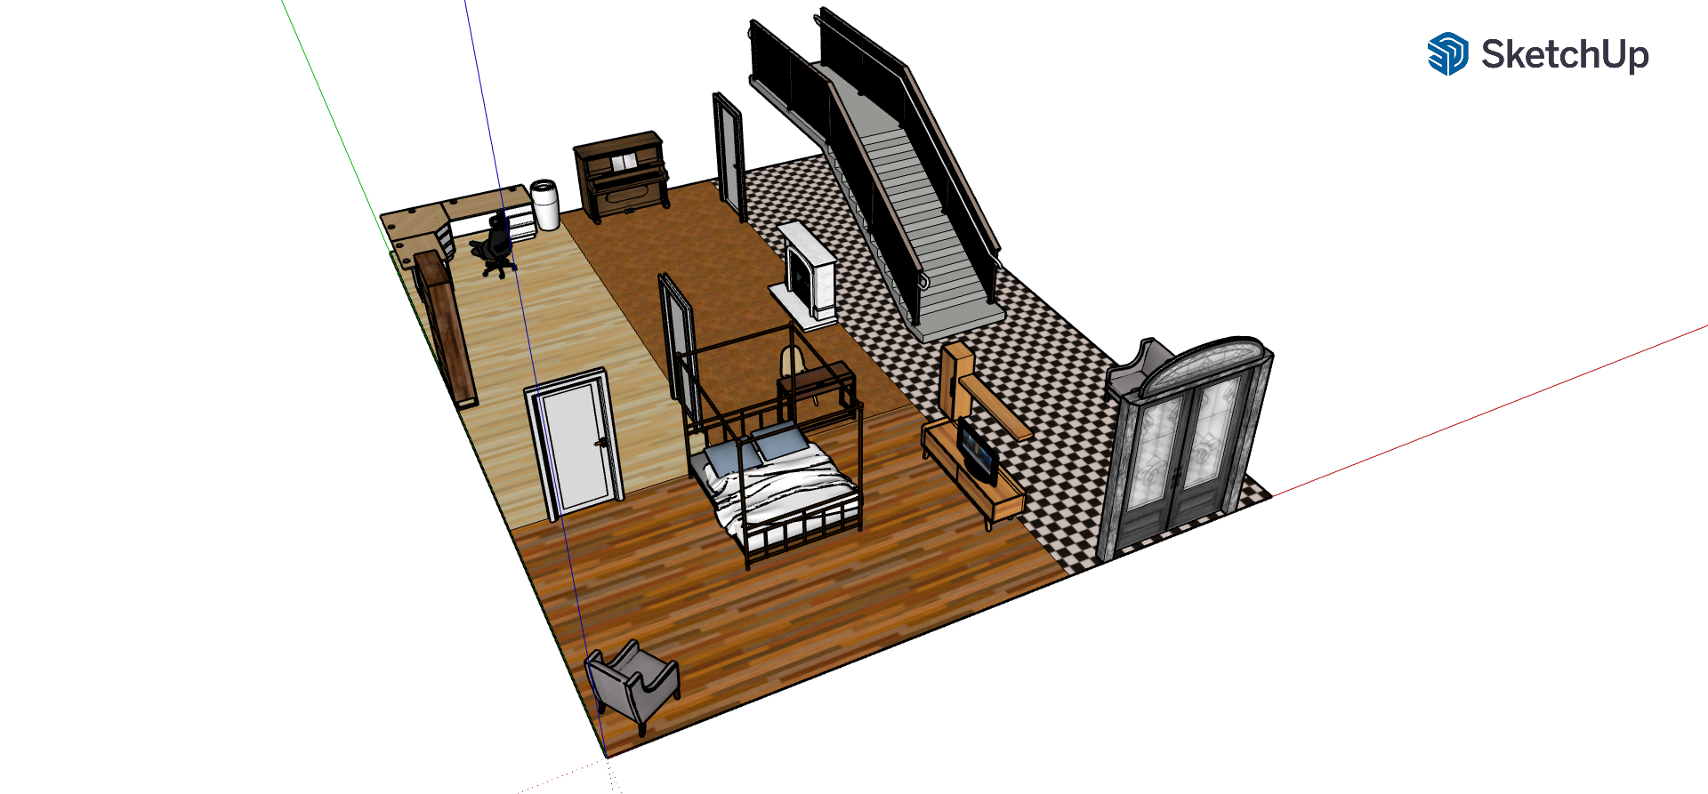
Escape the rooms as quickly as possible using the keys hidden along the way

Slide 6
PYTHON HAS NEVER BEEN SO SCARY!

Slide 7

Join the Python Hotel Slack Community and be one of the first to know about upcoming updates!
Upcoming Updates:
Dev’s Team:
Ingrid Firmino
Jorge Maia
Tamara Costacurta
Sounds on each room
Minigames
Display improvements

